Slide 1
Health Coverage for Texas Women and the Role of Medicaid and CHIP
TMA Maternal Health Congress
March 24, 2018
Ryan D. Van Ramshorst, MD, Chair
Select Committee on Medicaid, CHIP, and the Uninsured

Slide 2
Texas Coverage Trends
United States Census (2009-2016). Health Insurance Tables. Retrieved from www.census.gov/topics/health/health-insurance/data/tables.2009.html
Notes:
Among women of reproductive age, the rate of uninsured dropped 7 percent from 2013 to 2016 according to Guttmacher Institute

Slide 3
Texas Women’s Health Insurance Coverage (2016)
Notes:
Nationally, 11 percent of women are uninsured. Note that programs such as Healthy Texas Women and Family Planning are not included as they are not technically insurance.

Slide 4
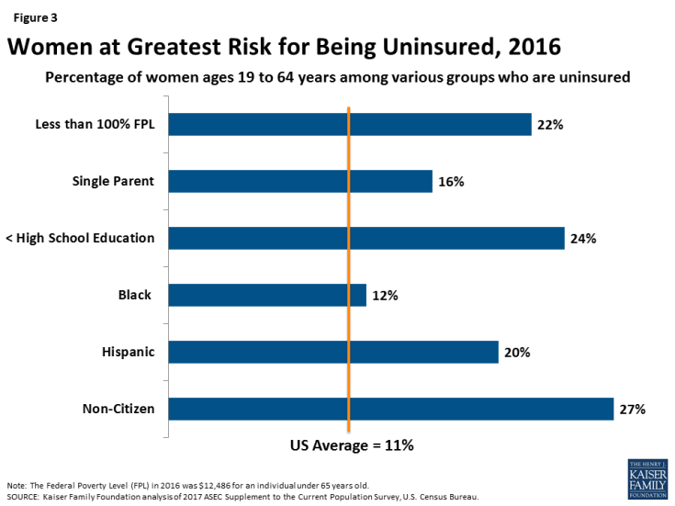

Slide 5
Who Is Covered by Texas Medicaid
Source: Texas Medicaid and CHIP Monthly Full Benefit Caseload By Risk Group, Jan. 2018
Notes:
Medicaid is largely a program of children and the aged/disabled; however pregnant women and low-income parents account for 7% of Texas Medicaid enrollees. Pregnant women enrollment = nearly 134,000; poor parents account for about 150,000.

Slide 6
Texas Medicaid – Who It Helps
*In 2018, federal poverty level is $12,140 for an individual and $20,780 for a family of 3
Source: Texas Medicaid and CHIP in Perspective, 11th edition
Notes:
Note that Texas provides more generous coverage than required by federal law for three populations: pregnant women, infants, and long term care. Of note, one of the early cost-saving measures discussed in the 85th legislative session was reducing optional availability for pregnant women (which TMA and partners advocated vehemently against).

Slide 7
Texas Medicaid — Who It Helps
4 million Texans — 1 in 7 — covered by Medicaid
Most recipients live below the poverty level (83%)
Most recipients are young (78%)
Most recipients are female (55%)
Medicaid pays for 52 percent of all births
Medicaid is the largest source of behavioral health care, providing pregnant women comprehensive substance use disorder and mental health treatment
Texas Medicaid and CHIP in Perspective, 11th Edition (2017). 2015 Data. Retrieved from Texas Medicaid and CHIP in Perspective

Slide 8
… And Who It Does Not
Medicaid is not available to all poor or low-income women:
Must have limited income and qualify categorically
Pregnant women lose Medicaid 60 days postpartum unless they qualify for Medicaid based on income
Populations not covered:
Healthy, childless adults (optional under ACA’s expansion)
Texas parents earning more than $3,800/year
Undocumented immigrants, except in an emergency
Legal immigrants (although Texas has option for coverage)

Slide 9
Why Medicaid Matters to Low-Income Women
Medicaid is key to improving women’s health and addressing Texas’ alarmingly high rate of maternal mortality and morbidity
52% of births in Texas covered by Medicaid
42% of pregnant women on Medicaid are between age 19 and 24
Provides preventive, prenatal, and postpartum care and complements Texas’ women’s preventive health programs
Healthy Texas Women and Family Planning Program
For uninsured low-income women, Medicaid also provides breast and cervical cancer screening and treatment
Sources: HHSC Presentation Report to Senate Finance 2017; Texas Medicaid and CHIP in Perspective 11th edition

Slide 10
CHIP Perinatal
State-federal program established by the Texas legislature in 2005
Provides limited benefits to uninsured low-income women who do not qualify for Medicaid because of their income or immigration status
Eligibility applies to the unborn child of a pregnant woman
To qualify, a pregnant woman must
Earn at or below 200% of federal poverty
Be a Texas resident

Slide 11
CHIP Perinatal
Benefits
Up to 20 prenatal visits
Prenatal vitamins, prescription drugs, and vaccinations
Limited laboratory testing, and diabetic testing and supplies
Labor and delivery (professional and hospital services)
Two postpartum visits
Among services excluded are inpatient and outpatient care unrelated to prenatal care or delivery, such as treatment for asthma and heart disease, and treatment for mental health and substance use disorders
Women enrolled in CHIP-P are not auto-enrolled in the Family Planning Program when eligibility ends

Slide 12
Women’s Preventive Health Programs
Texas operates two state-funded, preventive health care programs to provide preconception and interconception care to low-income, uninsured women:
Healthy Texas Women
Family Planning Program

Slide 13
Healthy Texas Women
State-funded,* limited-benefit program designed to increase uninsured, low-income women’s access to preventive health care
To qualify, a woman must be:
Uninsured, not pregnant, and with an income at or below 200 % of the federal poverty level ($50,200 for a family of 4 in 2018)
Age 15 to 44 (minors can participate with parental consent*)
A Texas resident and a U.S. citizen or legal immigrant
Adult women (18-44) receiving pregnancy-related Medicaid are automatically enrolled in HTW 60 days postpartum to improve postpartum care
Notes:
*In 2017, Texas submitted a federal 1115 Medicaid women’s health waiver. If approved, it would provide 90/10 federal matching dollars for family planning services, regular Medicaid match for other services. Texas will intends to maintain current HTW benefits and program design.

Slide 14
Healthy Texas Women
Benefits include:
Annual well-woman exam
Contraceptive counseling, prescriptions and devices, including long-acting reversible contraceptives (LARCs)
Breast and cervical cancer screening, including diagnostic services
Screening and treatment* for common chronic conditions, including diabetes, hypertension, cholesterol, and postpartum depression
Sexually transmitted disease services
Immunizations
Treatment for chronic conditions limited to primary care settings — specialty care not covered

Slide 15
Family Planning Program
State funded, limited-benefit program for low-income women (and men), primarily serving women not eligible for HTW because of immigration status
To be eligible, must be:
64 and younger
Income at or below 250% federal poverty level
Texas resident

Slide 16
Family Planning Program
Benefits include:
Annual well woman exam
Contraceptive counseling, prescriptions and devices, including LARCs
Screening for common chronic conditions (but not treatment)
Sexually-transmitted disease services
Breast and cervical cancer screening, including diagnostic services
Immunizations
Limited prenatal care

Slide 17
Clients Served by Women’s Health Programs
The Need Far Outweighs the Supply
Family Planning Program
WHP/TWHP/HTW
Expanded Primary Health Care
Women in Need**
Slide graciously provided by the Texas Women’s Healthcare Coalition
Sources: *Texas Health and Human Services, “HHS Women’s Health Update,” April 2017. EPHC numbers represent 60% of all EPHC clients to reflect proportion of EPHC funding designated for core family planning services. HHS data covers 11 months of FY 2016; data has been prorated to reflect a 12-month period. **Frost JJ, et al. "Contraceptive Needs and Services, 2014 Update," New York: Guttmacher Institute, 2016. FY 2016

Slide 18
Barriers to Reproductive Health Care in Texas
Roughly 1.8 million Texas women are in need of
publicly funded preventive health services.*
Slide graciously provided by the Texas Women’s Healthcare Coalition
Sources: *Frost et al., “Contraceptive Needs and Services, 2014 Update,” New York: Guttmacher Institute;
2016 Texas Population Research Project, Barriers to Family Planning Access in Texas: Evidence from a Statewide Representative Survey, May 2015
.

Slide 19
Medicaid Matters to Women and Families
Texas Medicaid health plans and commercial PPOs perform comparably on key maternal access to care and quality measures
In states that improved health coverage for low-income patients, large body of research has shown that:
Rate of uninsured and uncompensated care decreases
Patient access to physician services, prescription drugs, and self-reported health outcomes increases
Sources: Texas Medicaid Performance Study 2016, UT School of Public Health on behalf of Methodist Healthcare Ministries, Aug. 2016. Effects of Medicaid Expansion - Updated Findings Sept 2017, Kaiser Family Foundation, Sept 2017

Slide 20
Medicaid Matters to Women and Families
Medicaid is key to addressing social determinants of health
A recent study in Health Affairs found that Medicaid improves economic well-being of enrollees:
Medicaid is among the most effective antipoverty programs
Medicaid is particularly important for people of color
Medicaid impacts outcomes in addition to health:
Decreases financial hardship
Improves educational outcomes
Increases future tax payments by individuals
Sources: Estimating The Effects Of Health Insurance And Other Social Programs On Poverty Under The Affordable Care Act, Health Affairs, Oct 2017; Medicaid & CHIP are Long-Term Investments in Children’s Health and Future Success, April 2017.
Notes:
Social determinants of health as defined by CDC: “economic and social conditions that influence the health of people and communities”. Medicaid reduces poverty among enrollees by 17%.

Slide 21
Medicaid Matters to Women and Families
Recent changes to federal regulations encourage initiatives by states and Medicaid MCOs to address social determinants of health by providing nonclinical services that improve health outcomes and well being, such as:
Population health measures
Nutrition services/food security
Domestic violence
Peer support services
Housing supports
Environmental hazards (e.g., mold remediation in homes with children with asthma)
Source: Commonwealth Fund, Addressing the Social Determinants of Health Through Medicaid Managed Care, 2017

